Slide 1
Database Management Systems
Stored Procedures, Cursors and Triggers

Slide 2
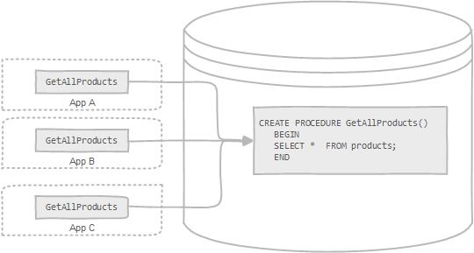
A stored procedure is a segment of declarative SQL statements stored inside the database catalog. A stored procedure can be invoked by triggers, other stored procedures, and applications such as Java, Python, PHP.

Slide 3
What Is a Stored Program?
A database stored program—sometimes called a stored module or a stored routine—is a computer program (a series of instructions associated with a name) that is stored within, and executes within, the database server.
The source code and (sometimes) any compiled version of the stored program are almost always held within the database server’s system tables as well.
When the program is executed, it is executed within the memory address of a database server process or thread.

Slide 4
There are three major types of MySQL stored programs:
Stored procedures
  Stored procedures are the most common type of stored program.
  A stored procedure is a generic program unit that is executed on request and that can accept multiple input and output parameters.

Slide 5
There are three major types of MySQL stored programs:
Stored functions
  Stored functions are similar to stored procedures, but their execution results in the return of a single value.
  Most importantly, a stored function can be used within a standard SQL statement, allowing the programmer to effectively extend the capabilities of the SQL language.

Slide 6
There are three major types of MySQL stored programs:
Triggers
  Triggers are stored programs that are activated in response to, or are triggered by, an activity within the database.
  Typically, a trigger will be invoked in response to a DML operation (INSERT, UPDATE, DELETE) against a database table.
  Triggers can be used for data validation or for the automation of denormalization.

Slide 7
Why Use Stored Programs?
The use of stored programs can lead to a more secure database.
Stored programs offer a mechanism to abstract data access routines, which can improve the maintainability of your code as underlying data structures evolve.
Stored programs can reduce network traffic, because the program can work on the data from within the server, rather than having to transfer the data across the network.
Stored programs can be used to implement common routines accessible from multiple applications—possibly using otherwise incompatible frameworks— executed either within or from outside the database server.
Database-centric logic can be isolated in stored programs and implemented by programmers with more specialized, database experience.
The use of stored programs can, under some circumstances, improve the portability of your application

Slide 8
Stored Procedures in MySQL
A stored procedure is a prepared SQL code that you can save, so the code can be reused over and over again.
So if you have an SQL query that you write over and over again, save it as a stored procedure, and then just call it to execute it.
You can also pass parameters to a stored procedure, so that the stored procedure can act based on the parameter value(s) that is passed.
Syntax:
  CREATE PROCEDURE procedure_name
  AS
  sql_statement
  GO;

Slide 9
Stored Procedures in MySQL
Execute a Stored Procedure Syntax
EXEC procedure_name;
Example:
The following SQL statement creates a stored procedure
named "SelectAllCustomers" that selects all records from
the "Customers" table:
CREATE PROCEDURE SelectAllCustomers
AS
SELECT * FROM Customers
GO;

Slide 10
Executing Stored Procedure
Execute the stored procedure SelectAllCustomers as follows:
EXEC SelectAllCustomers;

Slide 11
Stored Procedure With One Parameter
The following SQL statement creates a stored procedure that selects Customers from a particular City from the "Customers" table:
CREATE PROCEDURE SelectAllCustomers @City nvarchar(30)
AS
SELECT * FROM Customers WHERE City = @City
GO;
Execute the stored procedure above as follows:
EXEC SelectAllCustomers City = “Pune";

Slide 12
Stored Procedure With Multiple Parameters
Setting up multiple parameters is very easy. Just list each parameter and the data type separated by a comma as shown below.
The following SQL statement creates a stored procedure that selects Customers from a particular City with a particular PostalCode from the "Customers" table:
CREATE PROCEDURE SelectAllCustomers @City nvarchar(30), @PostalCode nvarchar(10)
AS
SELECT * FROM Customers WHERE City = @City AND PostalCode = @PostalCode
GO;

Slide 13
Executing Multiparameter Stored Procedure
Execute the stored procedure above as follows:
EXEC SelectAllCustomers City = “Pune", PostalCode = “411015";

Slide 14
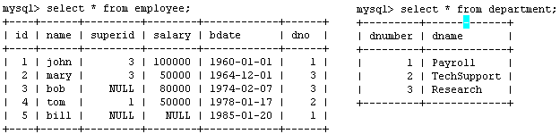
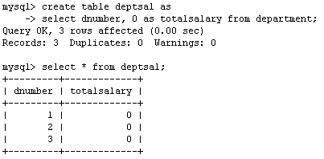
Example
Suppose we want to keep track of the total salaries of employees working for each department
We need to write a procedure to update the salaries in
the deptsal table

Slide 15
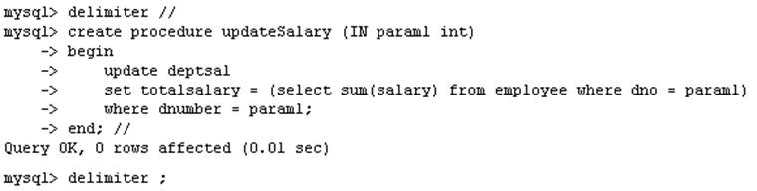
Example
Step 1: Change the delimiter (i.e., terminating character) of SQL statement from semicolon (;) to something else (e.g., //)
So that you can distinguish between the semicolon of the SQL statements in the procedure and the terminating character of the procedure definition

Slide 16
Example
Step 2:
Define a procedure called updateSalary which takes as input a department number.
The body of the procedure is an SQL command to update the totalsalary column of the deptsal table.
Terminate the procedure definition using the delimiter you had defined in step 1 (//)

Slide 17
Example
Step 3: Change the delimiter back to semicolon (;)

Slide 18
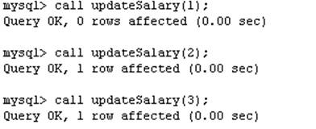
Example
Step 4: Call the procedure to update the totalsalary for each department

Slide 19
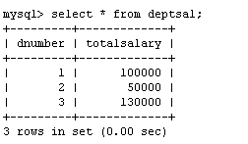
Example
Step 5: Show the updated total salary in the deptsal table

Slide 20
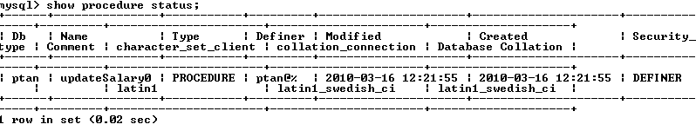

Stored Procedures in MySQL
Use show procedure status to display the list of stored procedures you have created
Use drop procedure to remove a stored procedure

Slide 21
Stored Procedures in MySQL
You can declare variables in stored procedures
You can use flow control statements (conditional IF-THEN-ELSE or loops such as WHILE and REPEAT)
MySQL also supports cursors in stored procedures.
  A cursor is used to iterate through a set of rows returned by a query so that we can process each individual row.
To learn more about stored procedures, go to:
  http://www.mysqltutorial.org/mysql-stored-procedure-tutorial.aspx

Slide 22
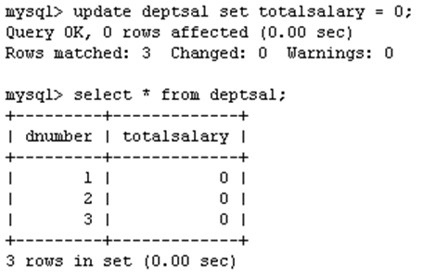
Example using Cursors
The previous procedure updates one row in deptsal table based on input parameter
Suppose we want to update all the rows in deptsal simultaneously
  First, let’s reset the totalsalary in deptsal to zero

Slide 23
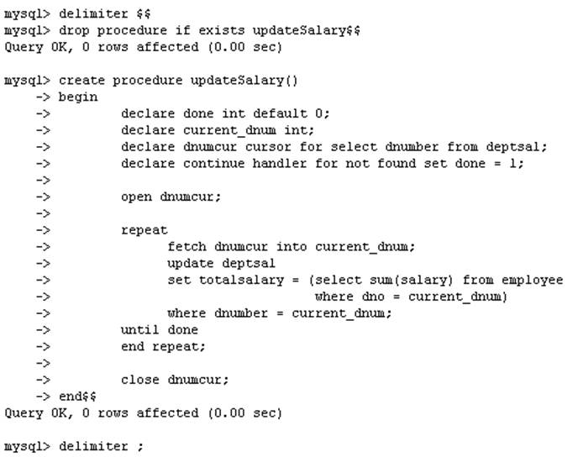
Example using Cursors
Drop the old procedure
Use cursor to iterate the rows

Slide 24
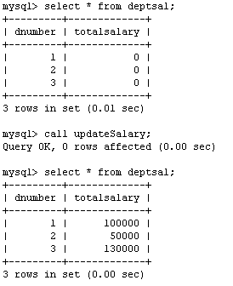
Example using Cursors
Call procedure

Slide 25
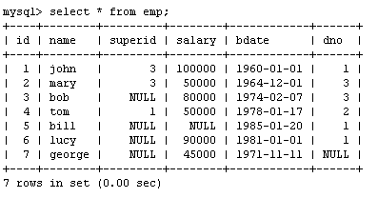
Another Example
Create a procedure to give a raise to all employees

Slide 26
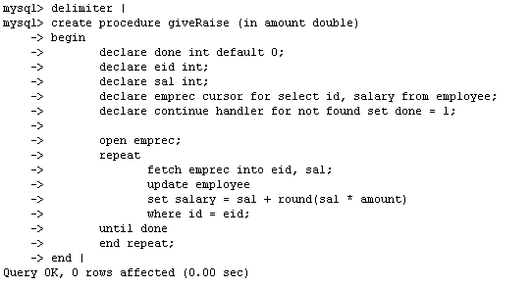
Another Example

Slide 27
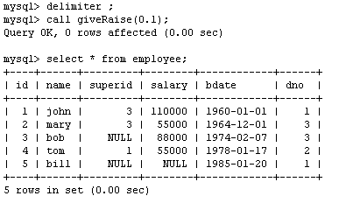
Another Example

Slide 28
Functions
Functions are declared using the following syntax:
  function <function-name> (param_spec₁, …, param_spec_{k})
  returns <return_type>
  [not] deterministic allow optimization if same output
  for the same input (use RAND not deterministic )
  Begin
  -- execution code
  end;
  where param_spec is:
  [in | out | in out] <param_name> <param_type>
  You need ADMIN privilege to create functions on mysql-user server

Slide 29
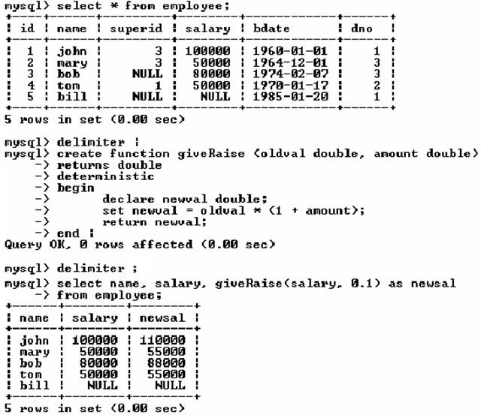
Example of Functions

Slide 30
Example of Functions

Slide 31
SQL Triggers
To monitor a database and take a corrective action when a condition occurs
  Examples:
    Charge $10 overdraft fee if the balance of an account after a withdrawal transaction is less than $500
    Limit the salary increase of an employee to no more than 5% raise
CREATE TRIGGER trigger-name
trigger-time trigger-event
ON table-name
FOR EACH ROW
trigger-action;
  trigger-time ∈ {BEFORE, AFTER}
  trigger-event ∈ {INSERT,DELETE,UPDATE}

Slide 32
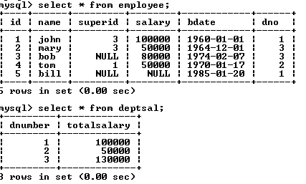
SQL Triggers: An Example
We want to create a trigger to update the total salary of a department when a new employee is hired

Slide 33
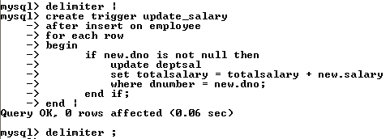
SQL Triggers: An Example
Create a trigger to update the total salary of a department when a new employee is hired:
The keyword “new” refers to the new row inserted

Slide 34
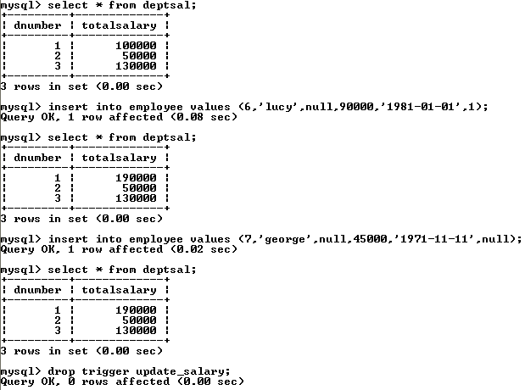
SQL Triggers: An Example
totalsalary increases by 90K
totalsalary did not change

Slide 35
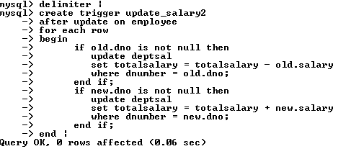
SQL Triggers: An Example
A trigger to update the total salary of a department when an employee tuple is modified:

Slide 36
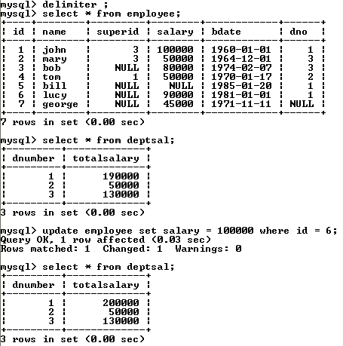
SQL Triggers: An Example

Slide 37
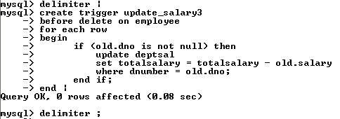
SQL Triggers: An Example
A trigger to update the total salary of a department when an employee tuple is deleted:

Slide 38
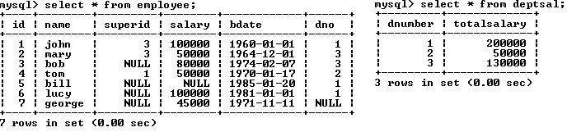
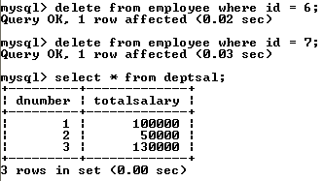
SQL Triggers: An Example

Slide 39
SQL Triggers
To list all the triggers you have created:
  mysql> show triggers;

